Slide 1
2021
Annual Competition
Part 2
Landscape
Wildlife
Pictorial - Colour
Pictorial - Monochrome

Slide 2
landscape
Stan Holbrook Trophy

Slide 3
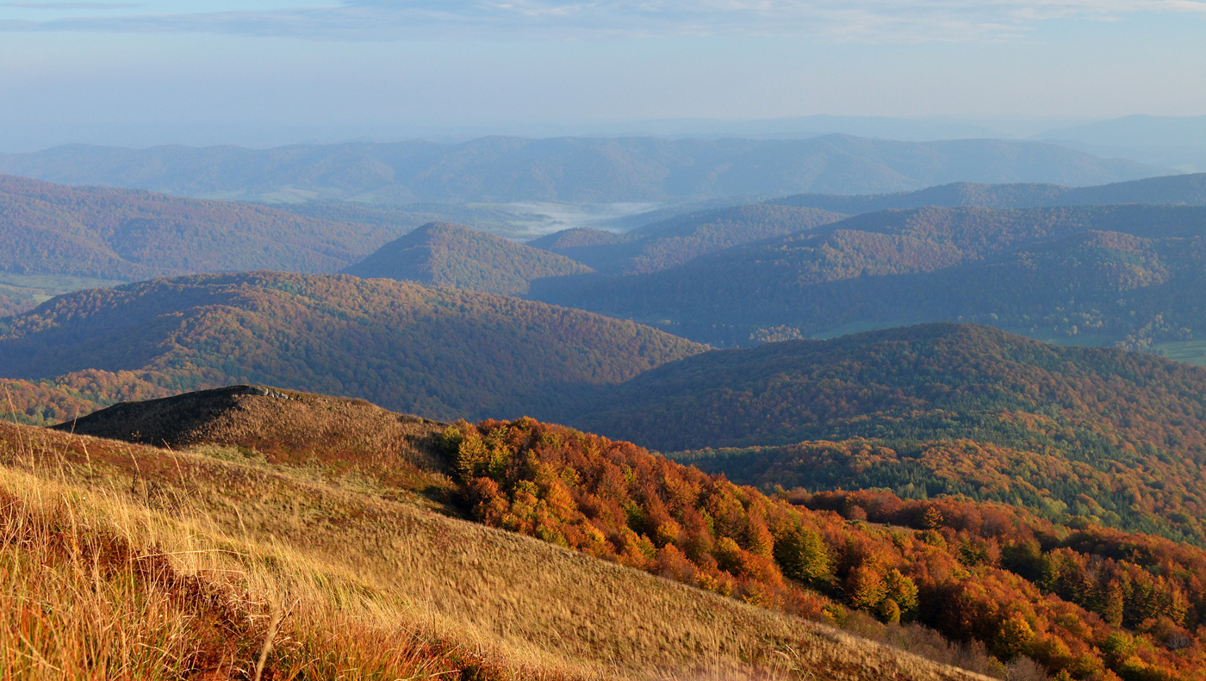
Angus Williamson
#1
ACROSS THE HILLS

Slide 4
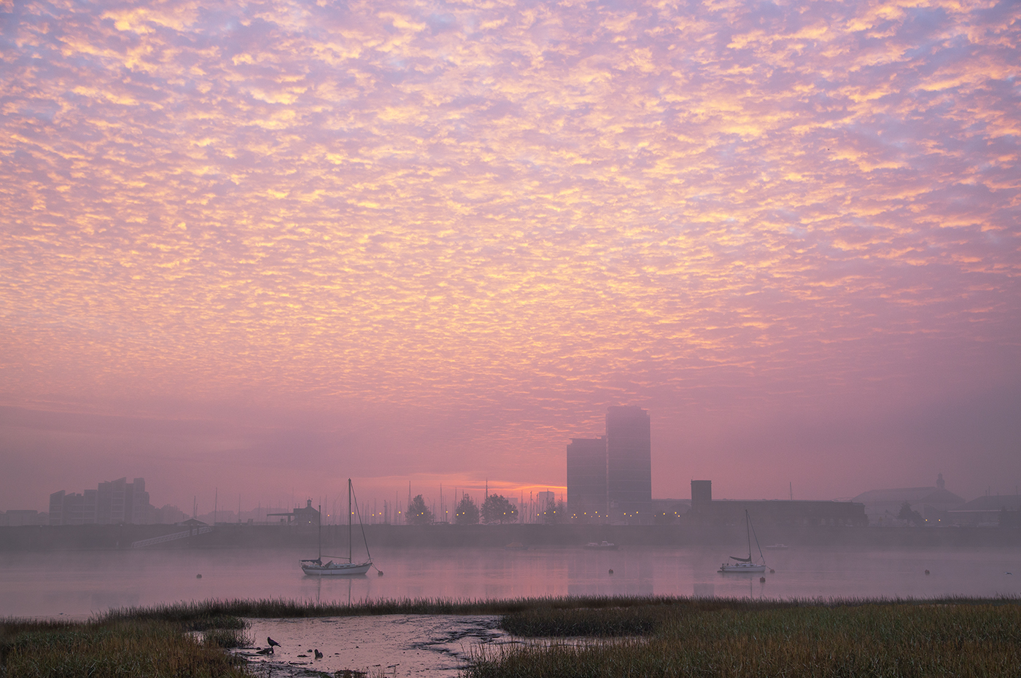
Pat Begley
#2 NOVEMBER DAWN
#1 EARLY MORNING ROW

Slide 5
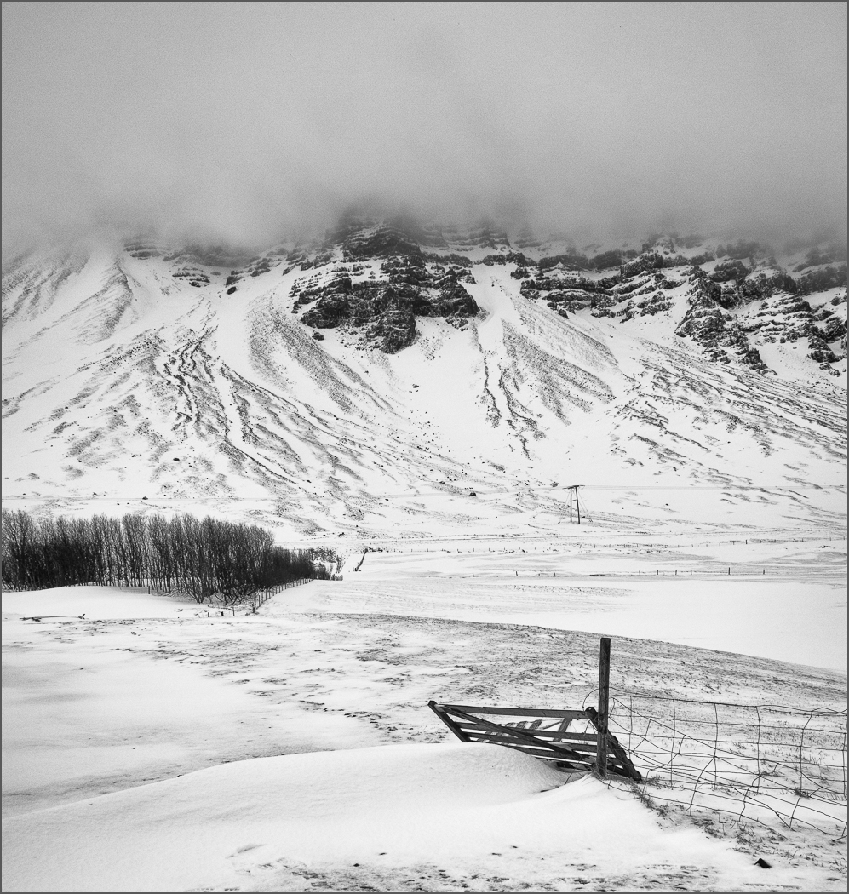
Teresa Hehir CPAGB
#3
PAST THE GATE
#1 EARLY MORNING ROW

Slide 6
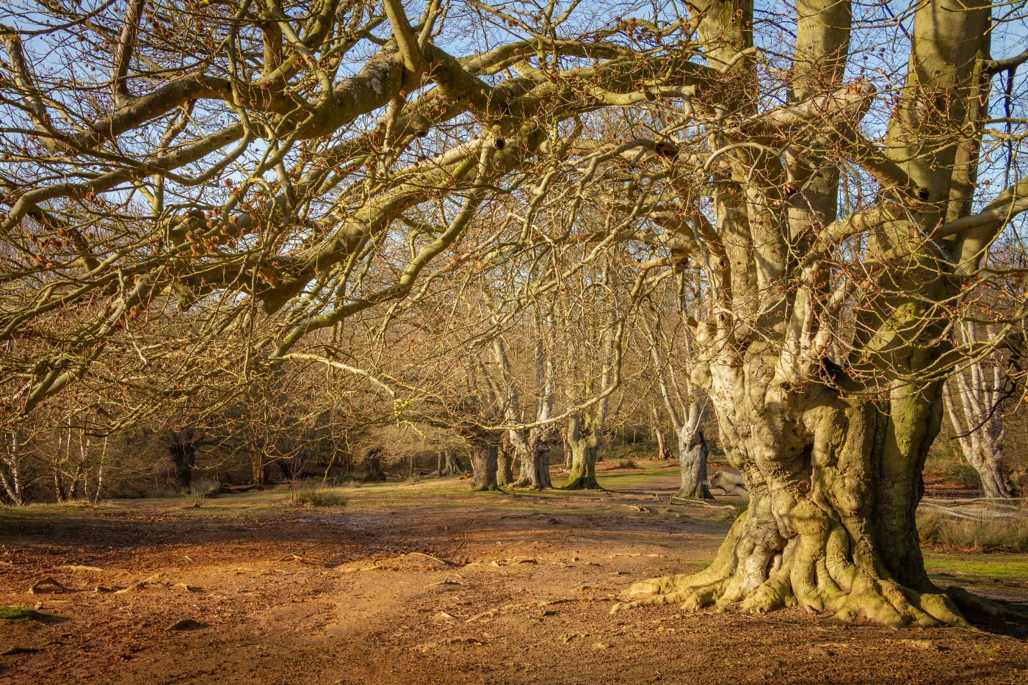
Paul Goby
#4
ANCIENT BEECHES
#1 EARLY MORNING ROW

Slide 7
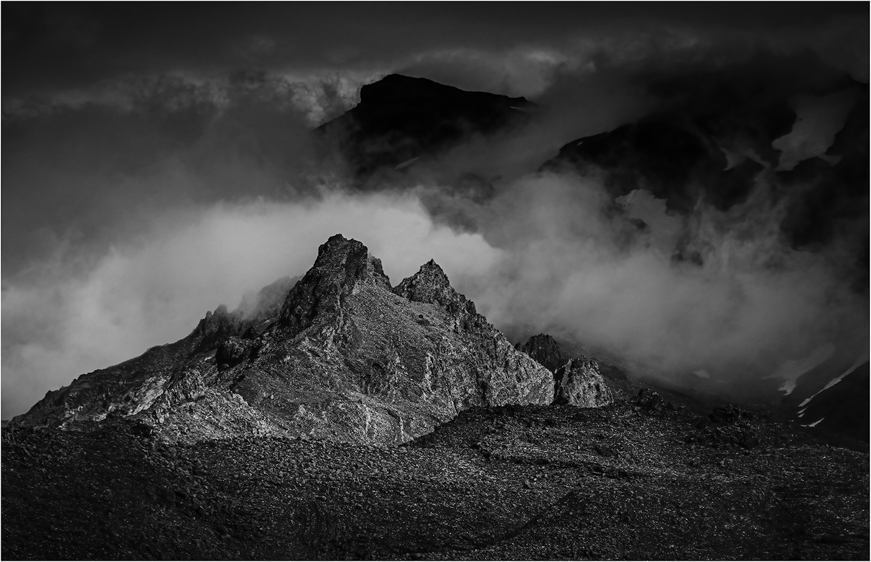
Hilary Pickersgill
#5
SUNLIT THROUGH THE CLOUDS
#1 EARLY MORNING ROW

Slide 8
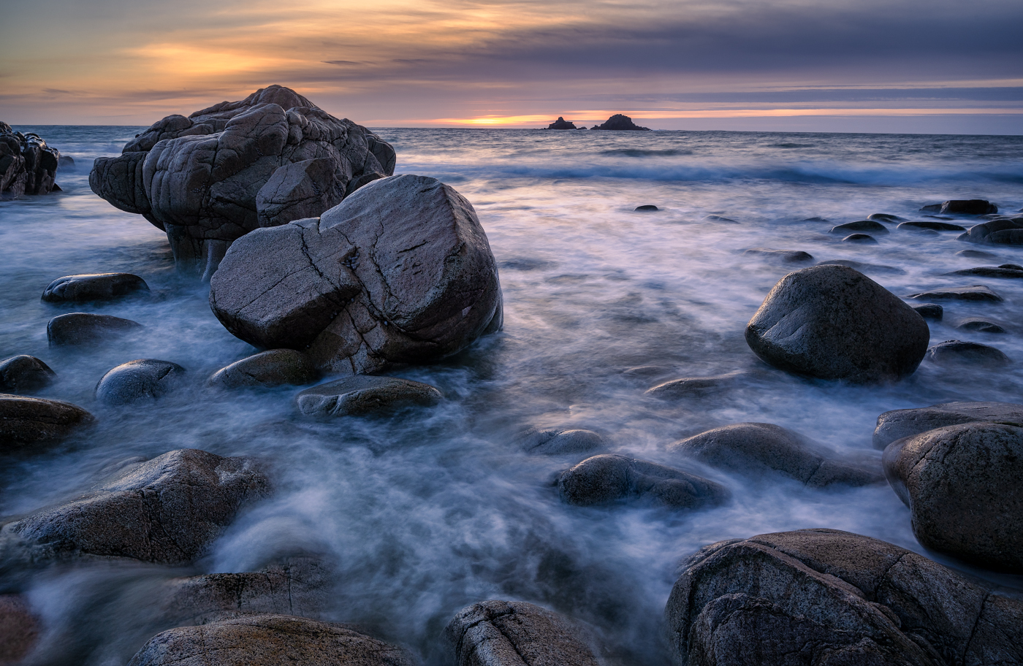
Jan Harris ARPS, CPAGB
#06
SUNSET AT PORTHNANVEN
#1 EARLY MORNING ROW

Slide 9
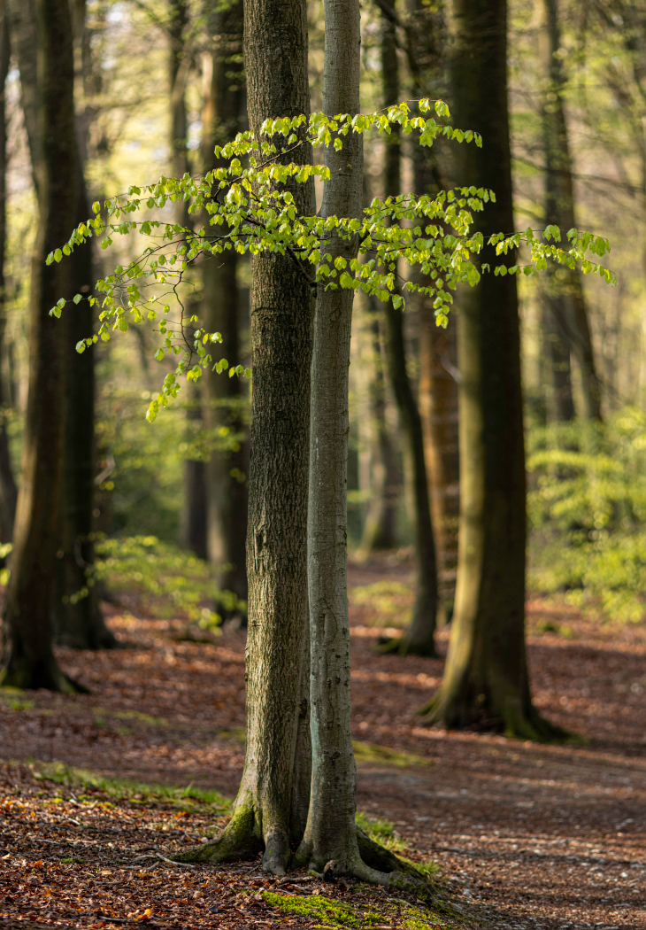
Paul Goby
#7
BEECH LEAVES IN THE SPRING
#1 EARLY MORNING ROW

Slide 10
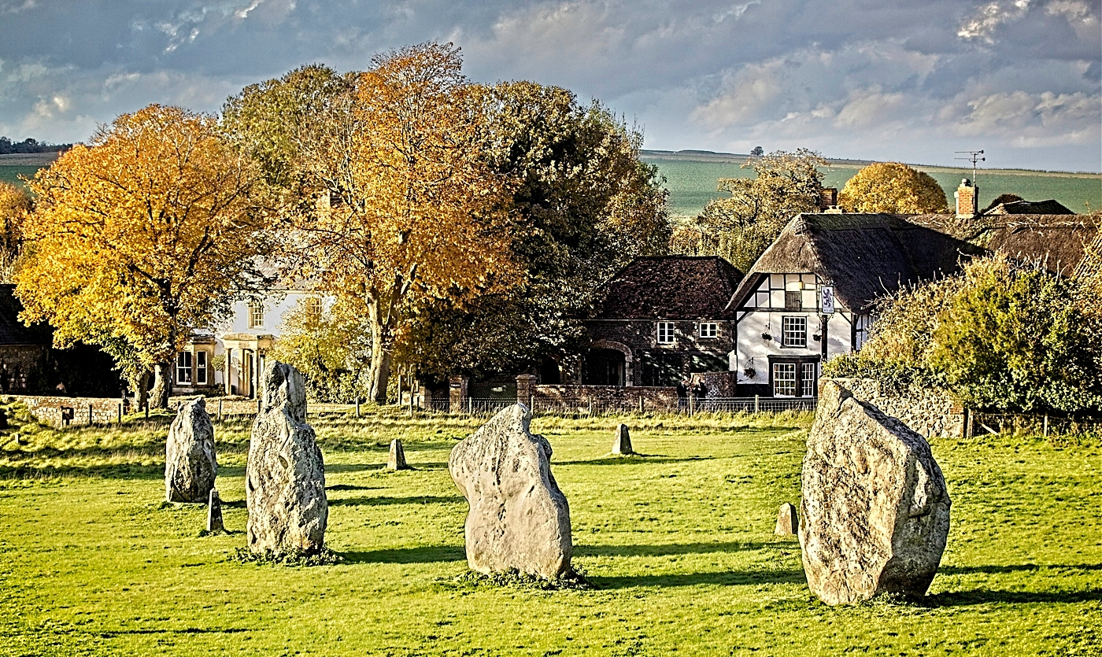
David Greenwood#8 AVEBURY AND RING
#1 EARLY MORNING ROW

Slide 11
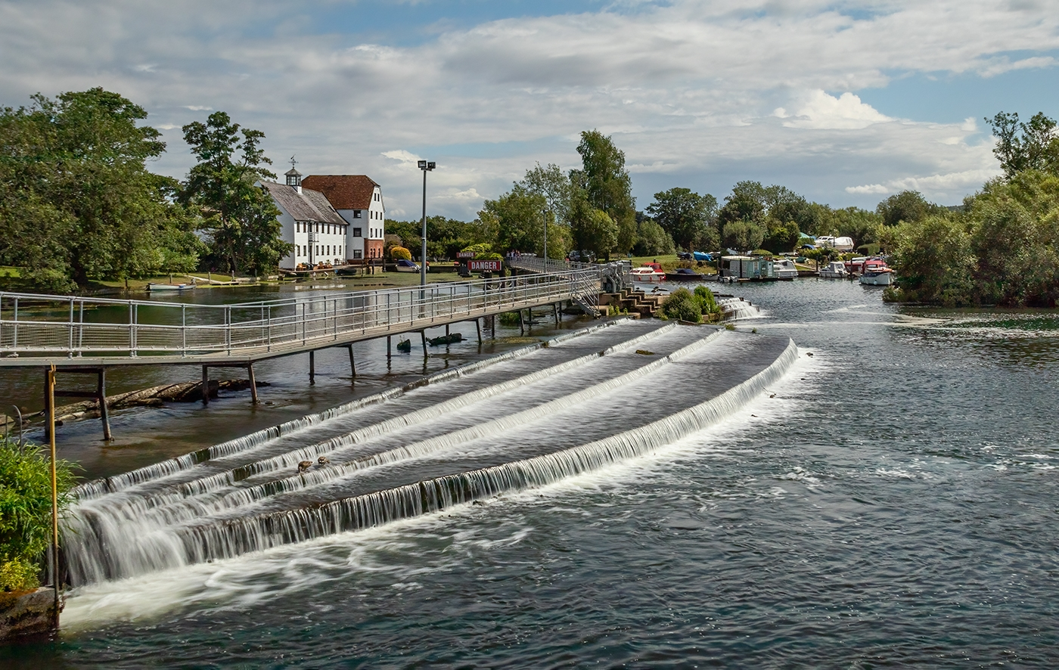
Hilary Pickersgill
#9 HAMBLEDEN WEIR
#1 EARLY MORNING ROW

Slide 12
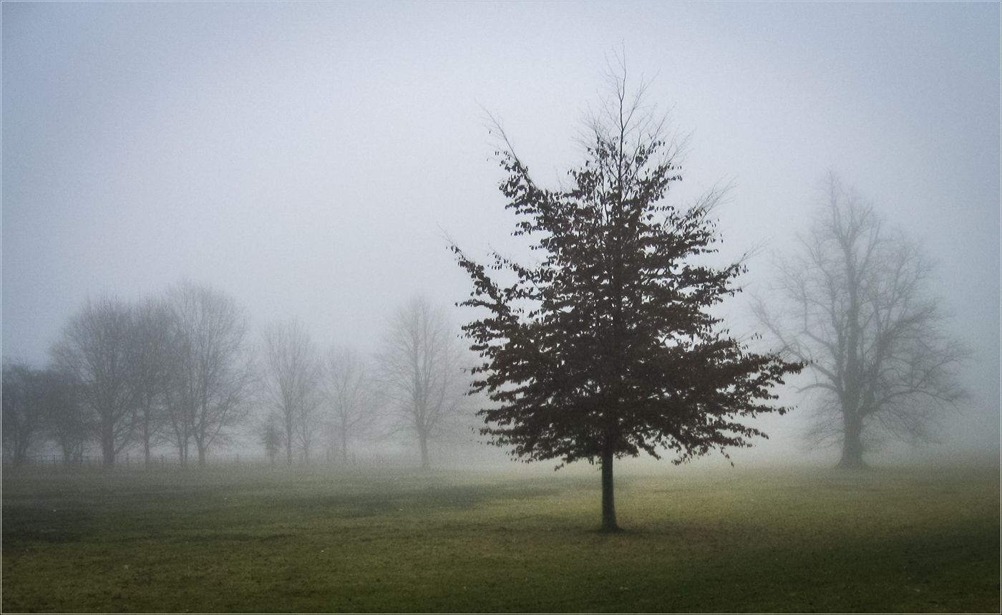
Peter Davis
#10
TREE IN THE MIST
#1 EARLY MORNING ROW

Slide 13
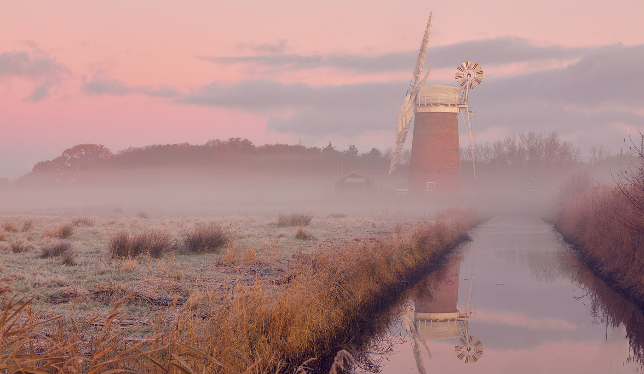
Allan Marshall
#11 HORSEY MILL NORFOLK
#1 EARLY MORNING ROW

Slide 14
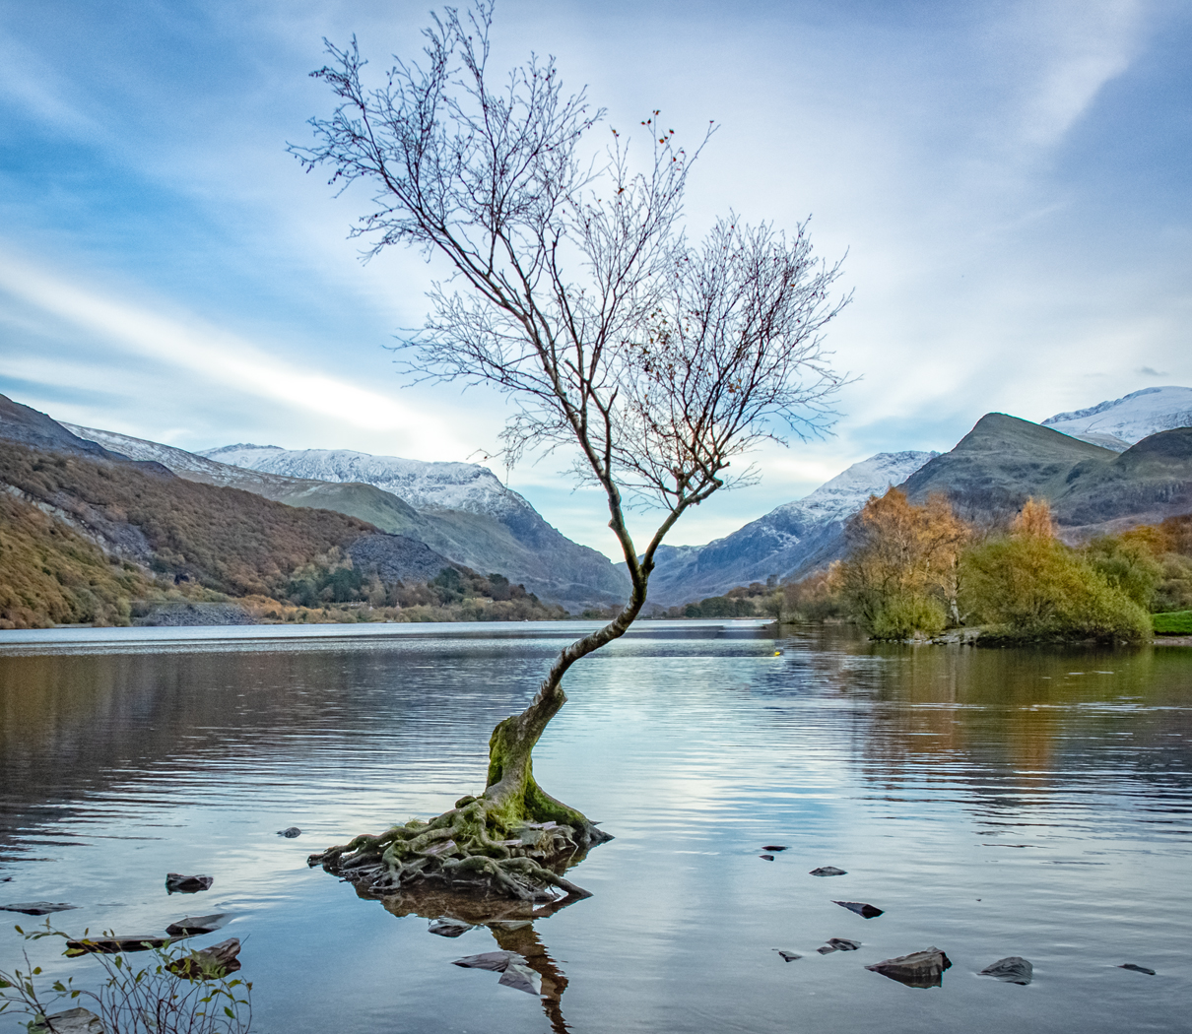
Allan Jaycock
#12
LONE TREE IN THE MORNING
#1 EARLY MORNING ROW

Slide 15
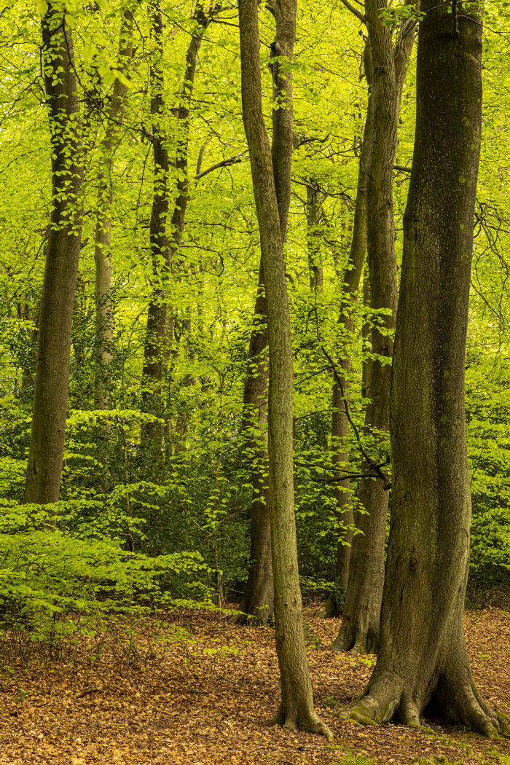
Paul Goby
#13
SUNNY SPRING BEECHES
#1 EARLY MORNING ROW

Slide 16
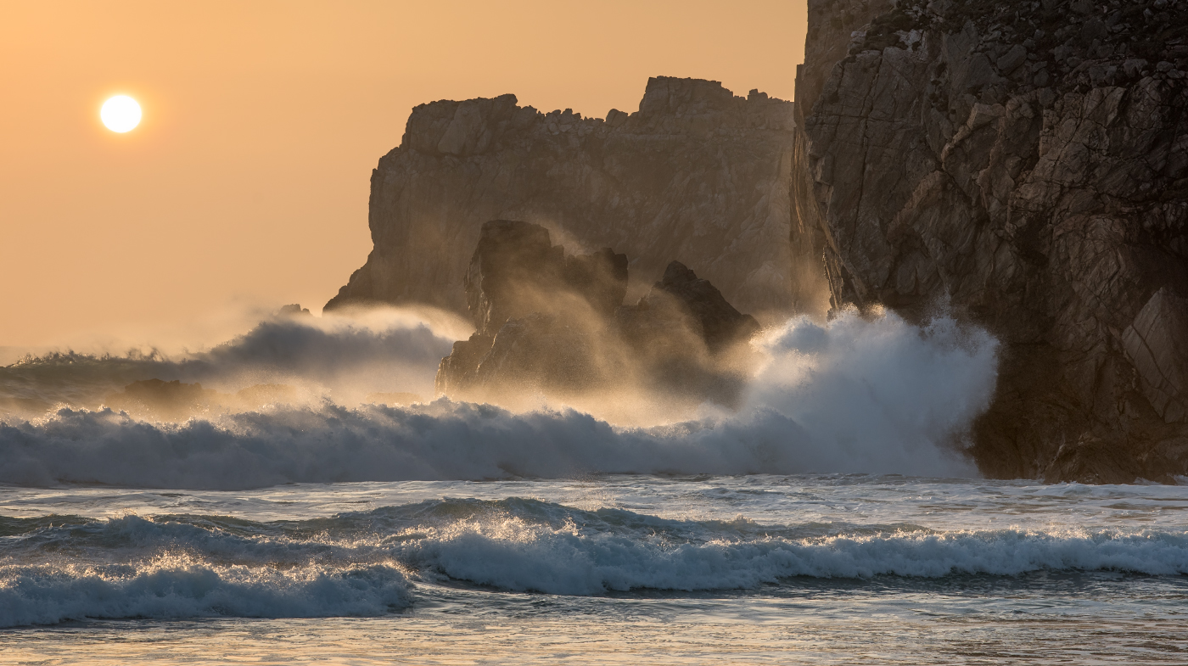
David Harris ARPS, CPAGB #14 SUNSET SURF

Slide 17
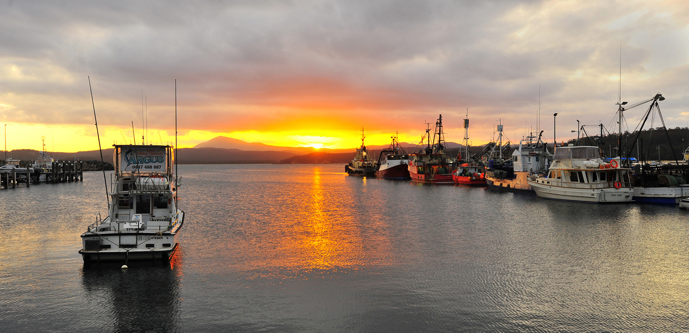
Angus Williamson
#15
EDEN SUNSET
#1 EARLY MORNING ROW

Slide 18
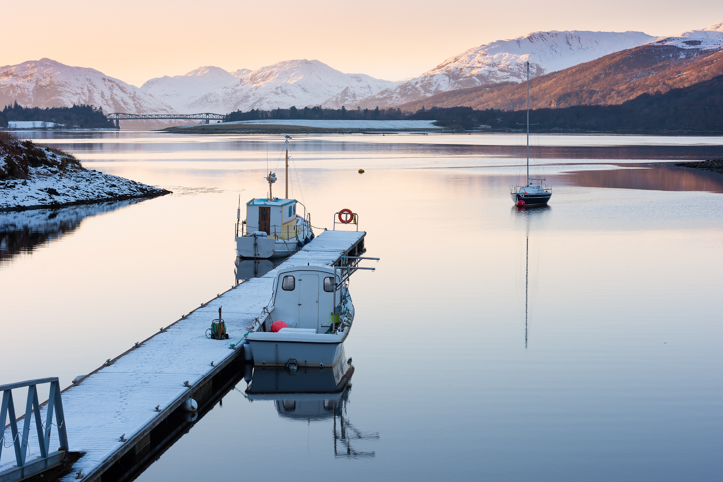
David Harris ARPS, CPAGB
#16
TRANQUIL LOCH LEVEN
#1 EARLY MORNING ROW

Slide 19
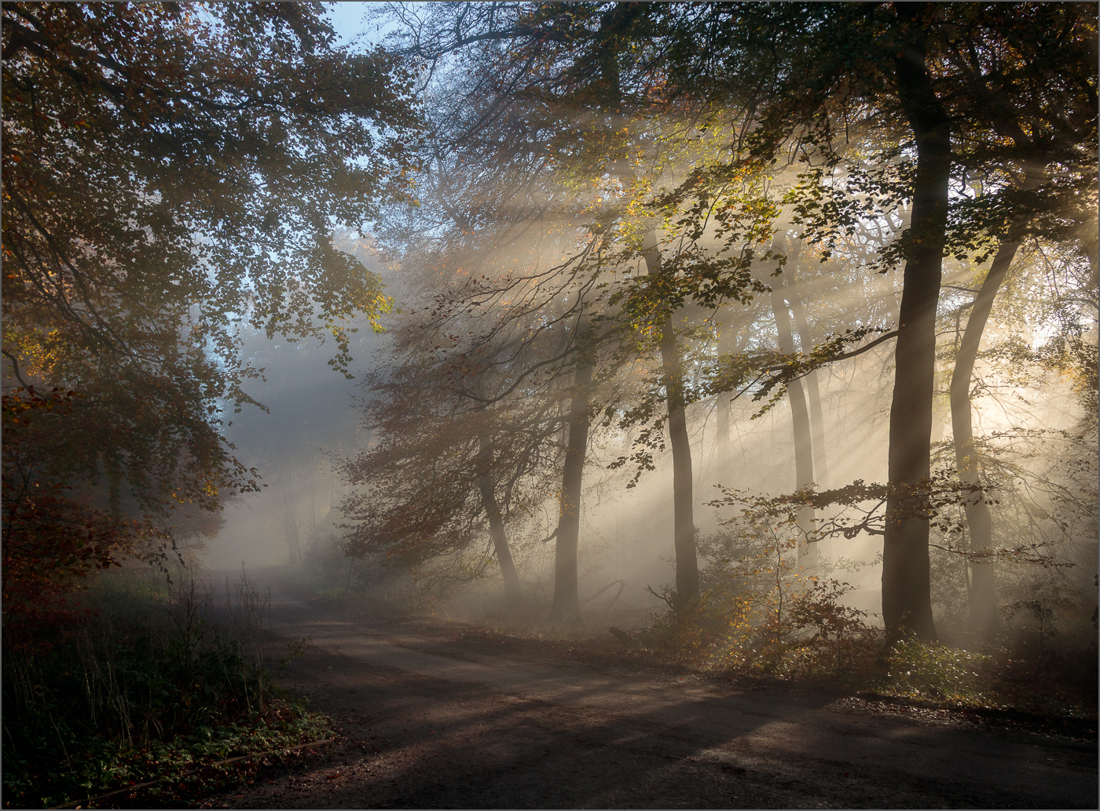
Teresa Hehir CPAGB
#17
ALONG THE ROAD
#1 EARLY MORNING ROW

Slide 20
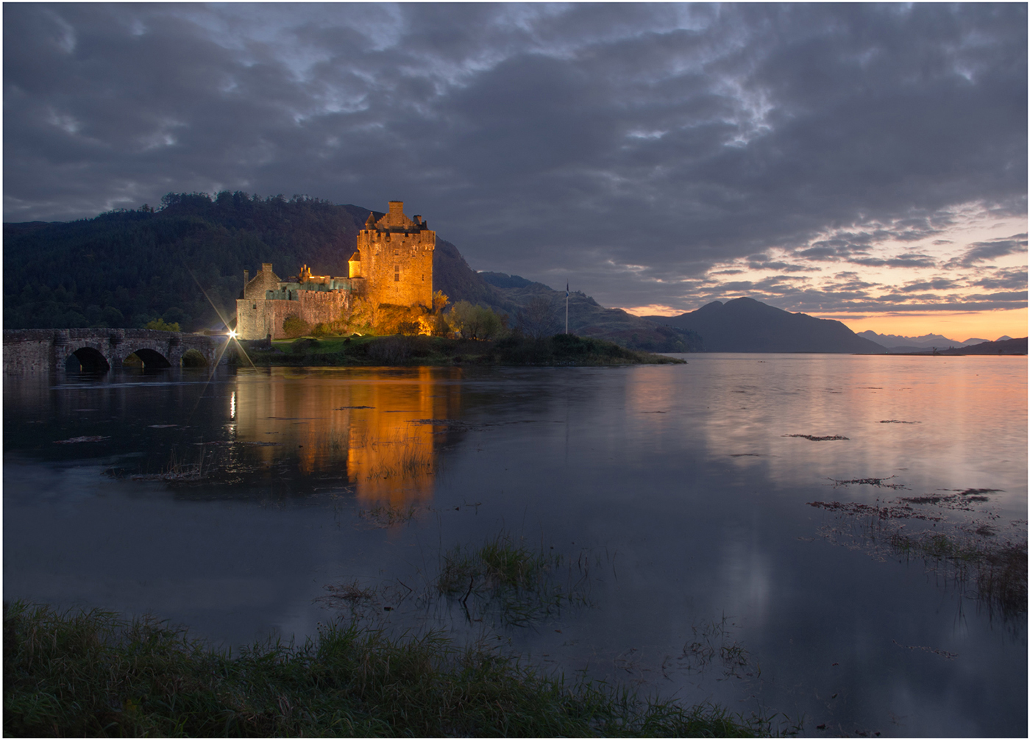
Pat Begley
#18
EILEAN DONAN CASTLE
#1 EARLY MORNING ROW

Slide 21
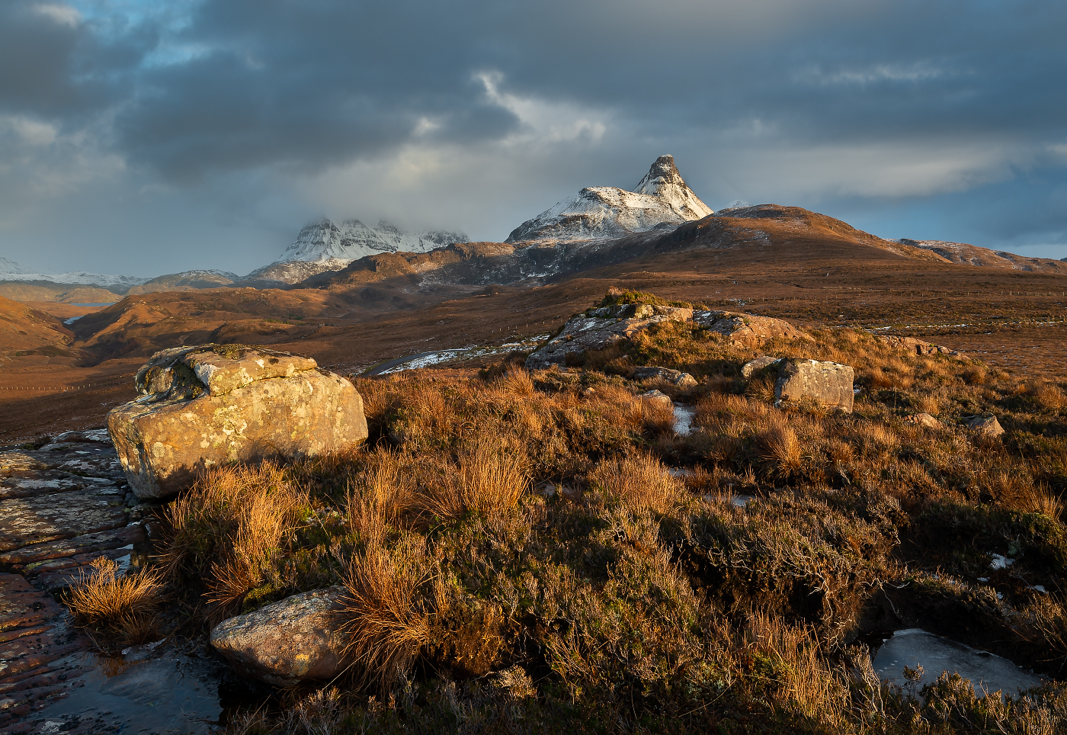
Jan Harris ARPS, CPAGB
#19
WINTER IN ASSYNT
#1 EARLY MORNING ROW

Slide 22
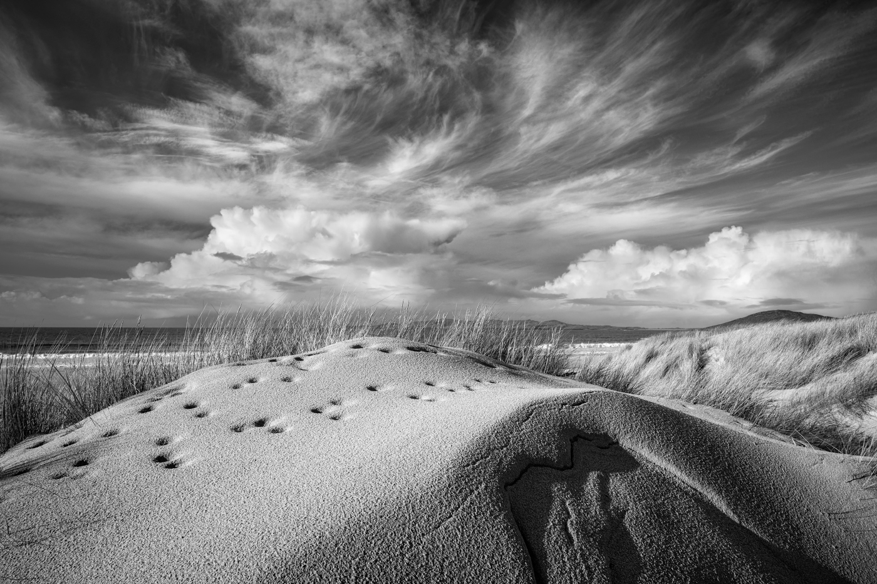
David Harris ARPS, CPAGB
#20
OVER TEXTURED DUNES
#1 EARLY MORNING ROW

Slide 23
Commended
#1 EARLY MORNING ROW

Slide 24
Allan Marshall #11 HORSEY MILL NORFOLK
#1 EARLY MORNING ROW

Slide 25
Highly Commended
#1 EARLY MORNING ROW

Slide 26
Hilary Pickersgill
#5
SUNLIT THROUGH THE CLOUDS
#1 EARLY MORNING ROW

Slide 27
David Harris ARPS, CPAGB
#20
OVER TEXTURED DUNES
#1 EARLY MORNING ROW

Slide 28
Winner of the
Stan Holbrook Trophy
#1 EARLY MORNING ROW

Slide 29
Jan Harris ARPS, CPAGB
#19
WINTER IN ASSYNT
#1 EARLY MORNING ROW

Slide 30
Pictorial - Colour
Derrick Bryant Trophy

Slide 31
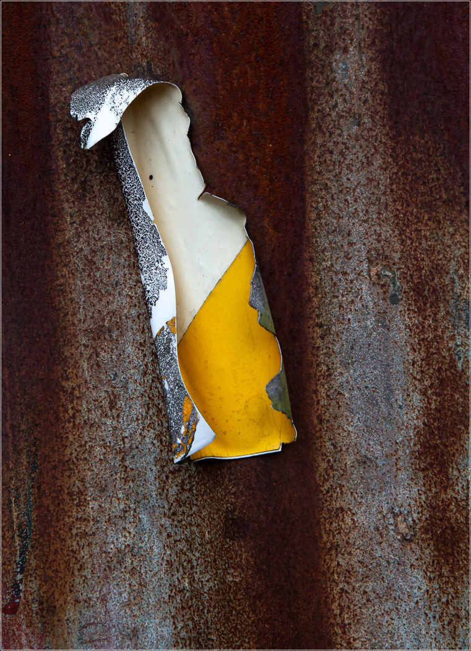
Peter Davis
#1
LOOSE PAINT
#1 EARLY MORNING ROW

Slide 32
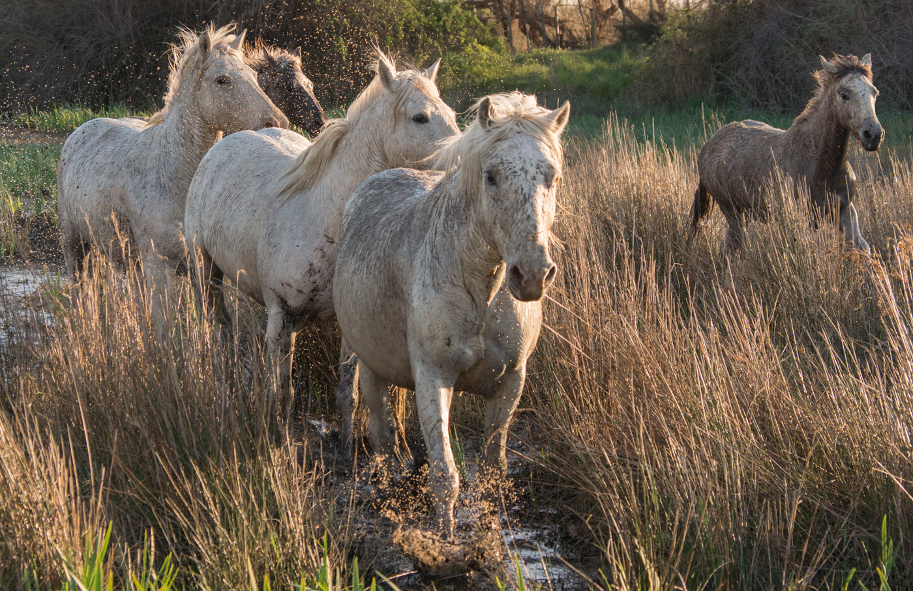
Pat Begley
#2
HORSES
#1 EARLY MORNING ROW

Slide 33
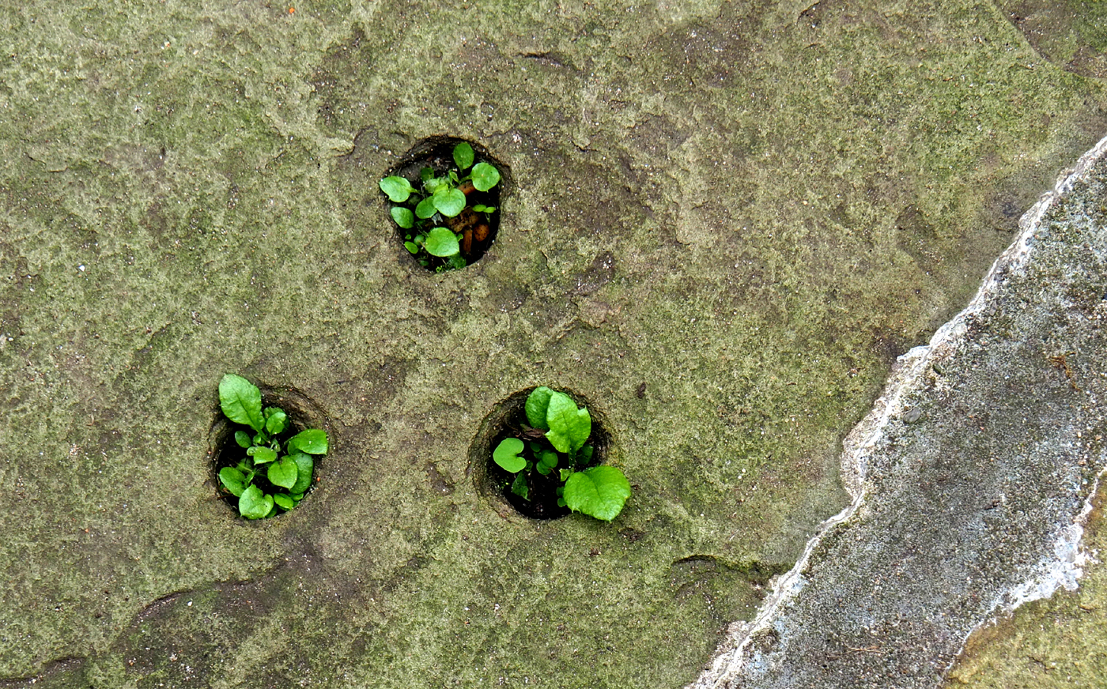
Deena Theaker
#2
NEW GROWTH
#1 EARLY MORNING ROW

Slide 34
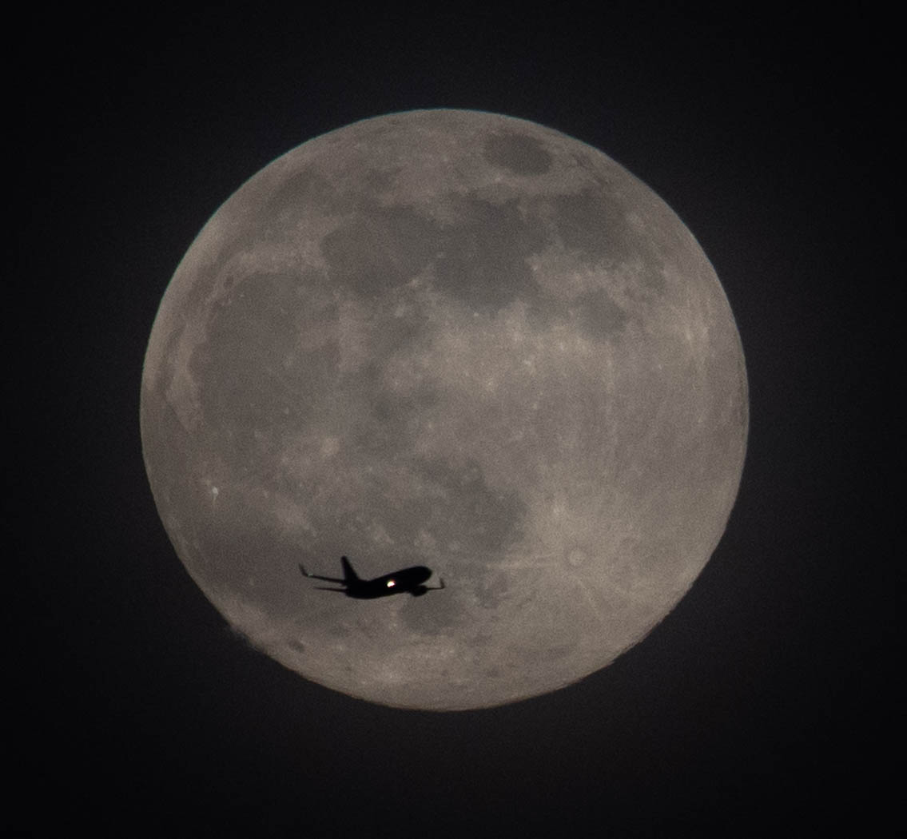
Brenda Spargo
#3
FLY ME PAST THE SUPERMOON
#1 EARLY MORNING ROW

Slide 35
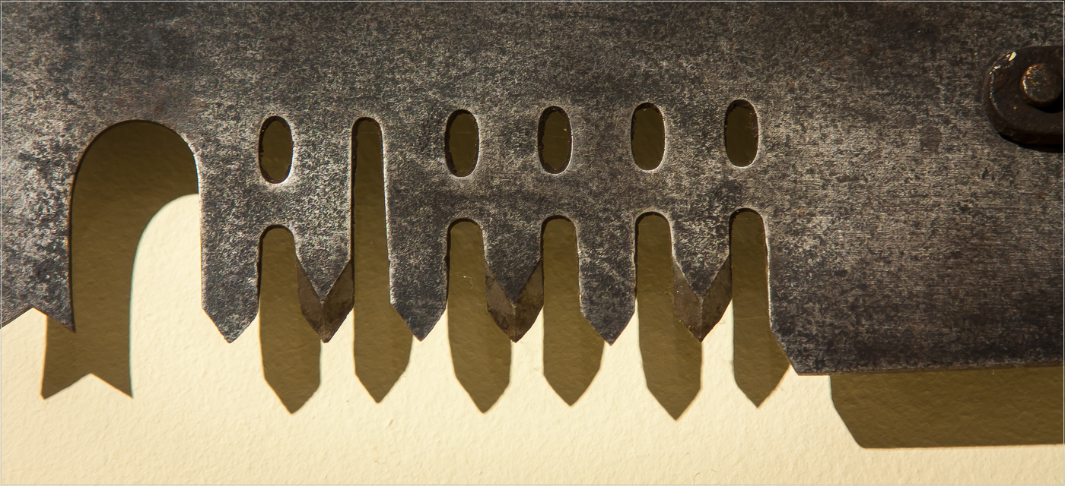
Peter Davis
#4
SAW TEETH
#1 EARLY MORNING ROW

Slide 36
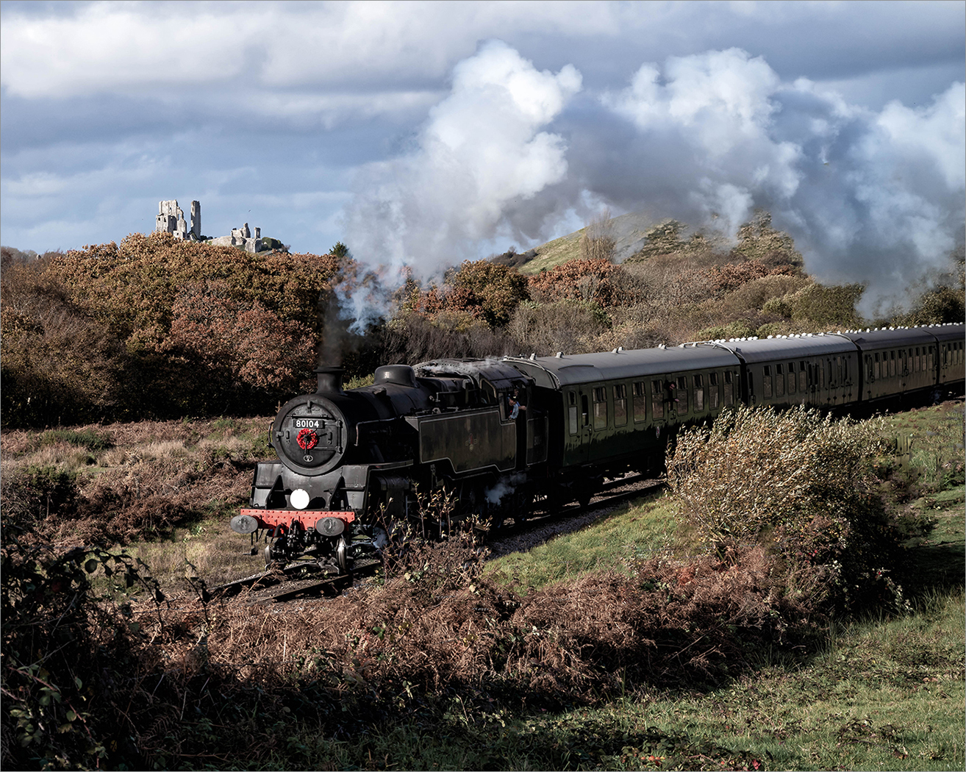
Alan Jaycock
#5
STEAM FROM CORFE CASTLE
#1 EARLY MORNING ROW

Slide 37
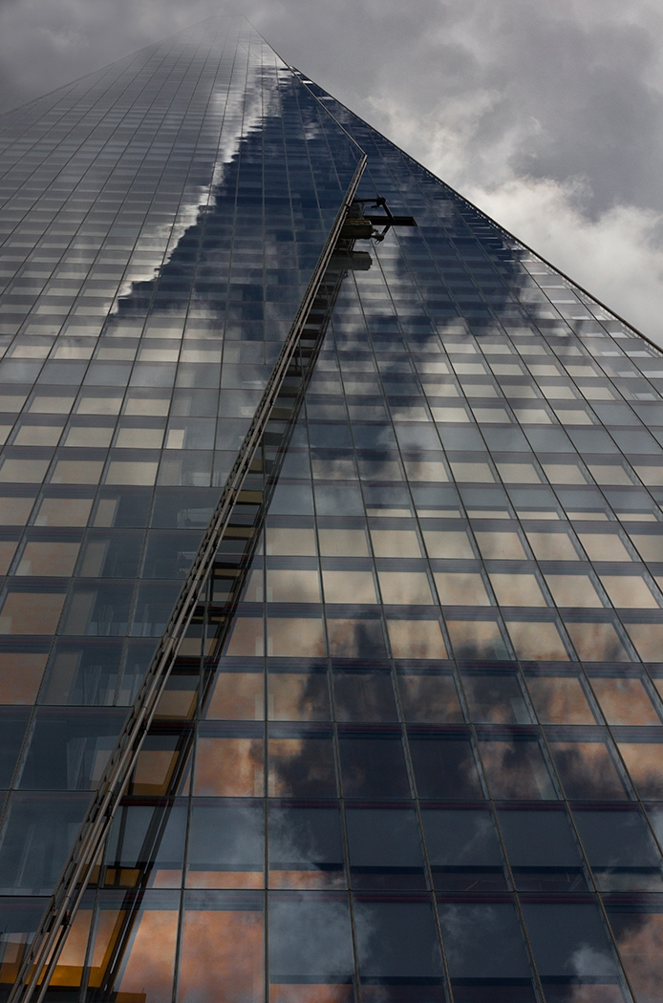
Hilary Pickersgill
#7
INTO THE CLOUDS
#1 EARLY MORNING ROW

Slide 38
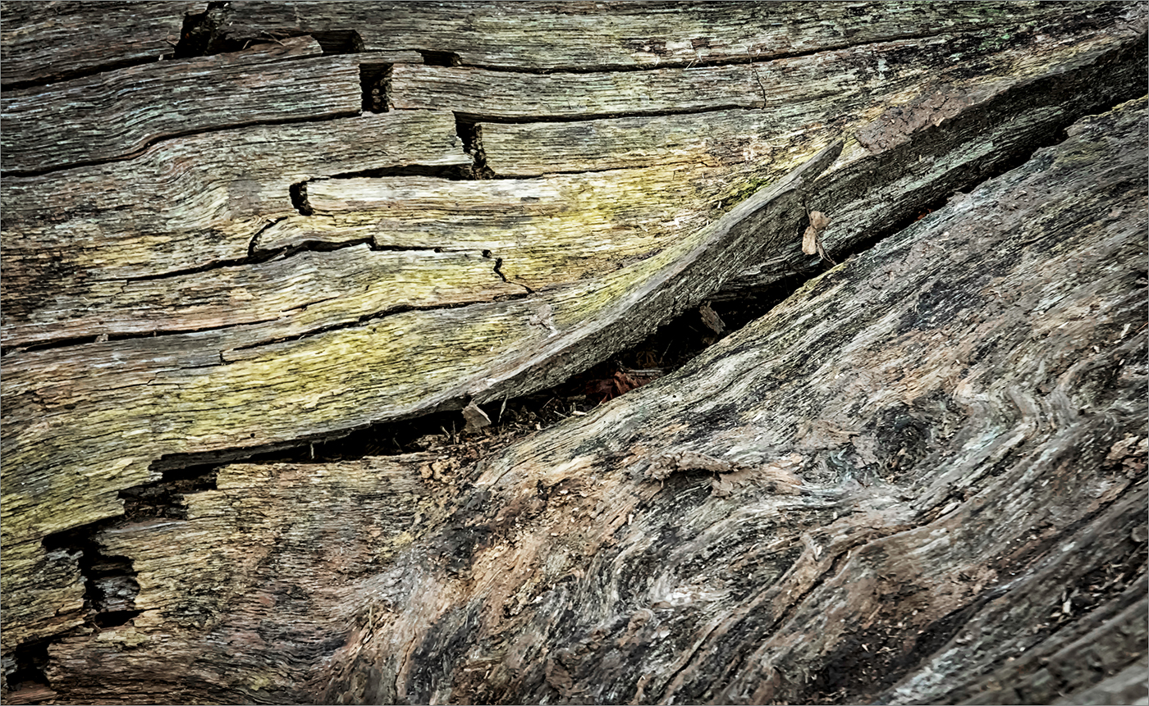
Allan Jaycock
#8
FALLEN TIMBER
#1 EARLY MORNING ROW

Slide 39
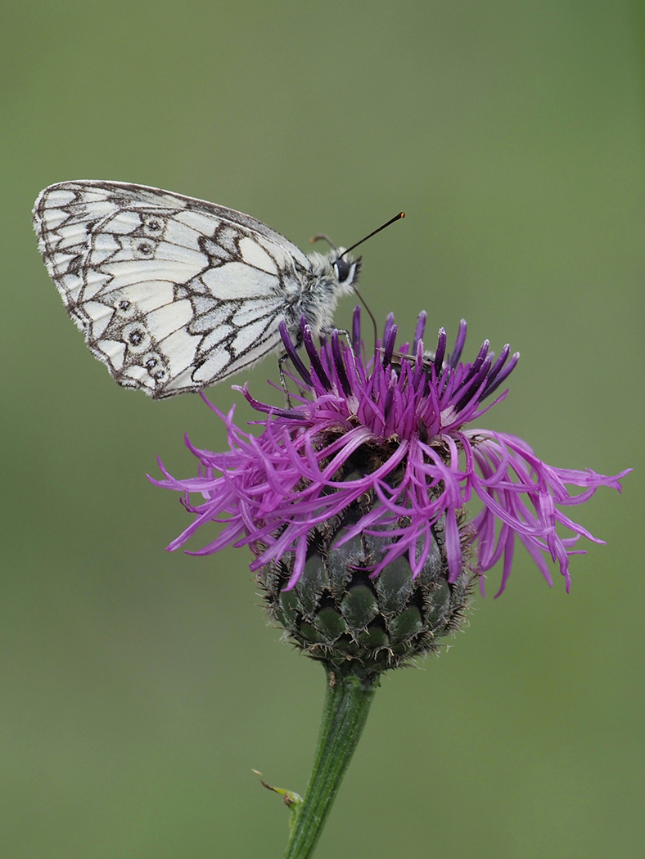
Claire Williams
#9
MARBLED WHITE
#1 EARLY MORNING ROW

Slide 40
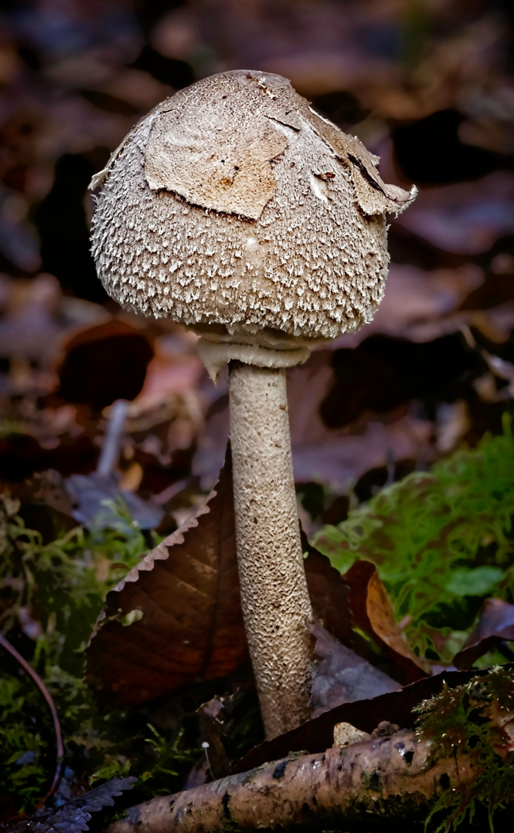
David Greenwood
#10
FUNGUS
#1 EARLY MORNING ROW

Slide 41
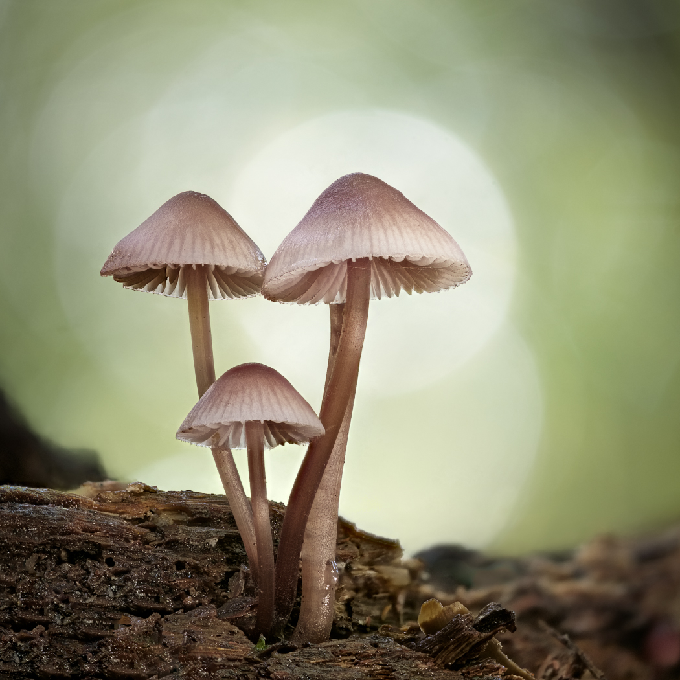
David Harris ARPS, CPAGB
#11
AUTUMN TRIO
#1 EARLY MORNING ROW

Slide 42
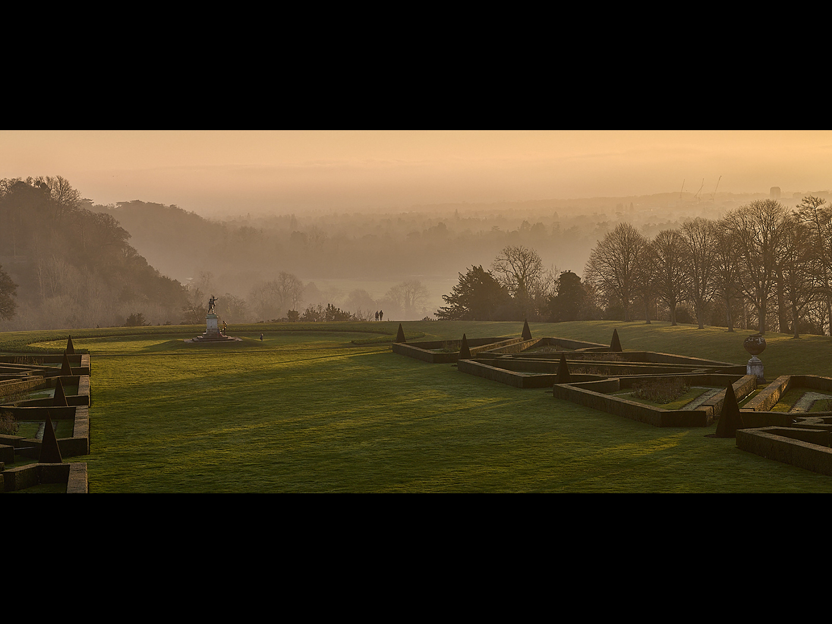
Allan Marshall
#12
DUSK TIME ACROSS THE PARTERRE AT CLIVEDEN
#1 EARLY MORNING ROW

Slide 43
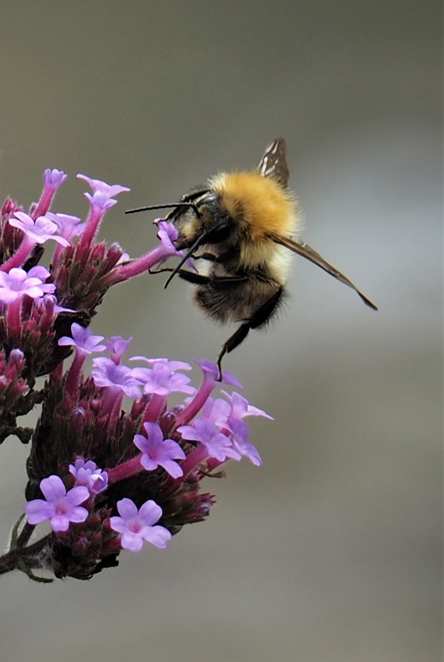
Deena Theaker
#13
BEE ON VERBENA
#1 EARLY MORNING ROW

Slide 44
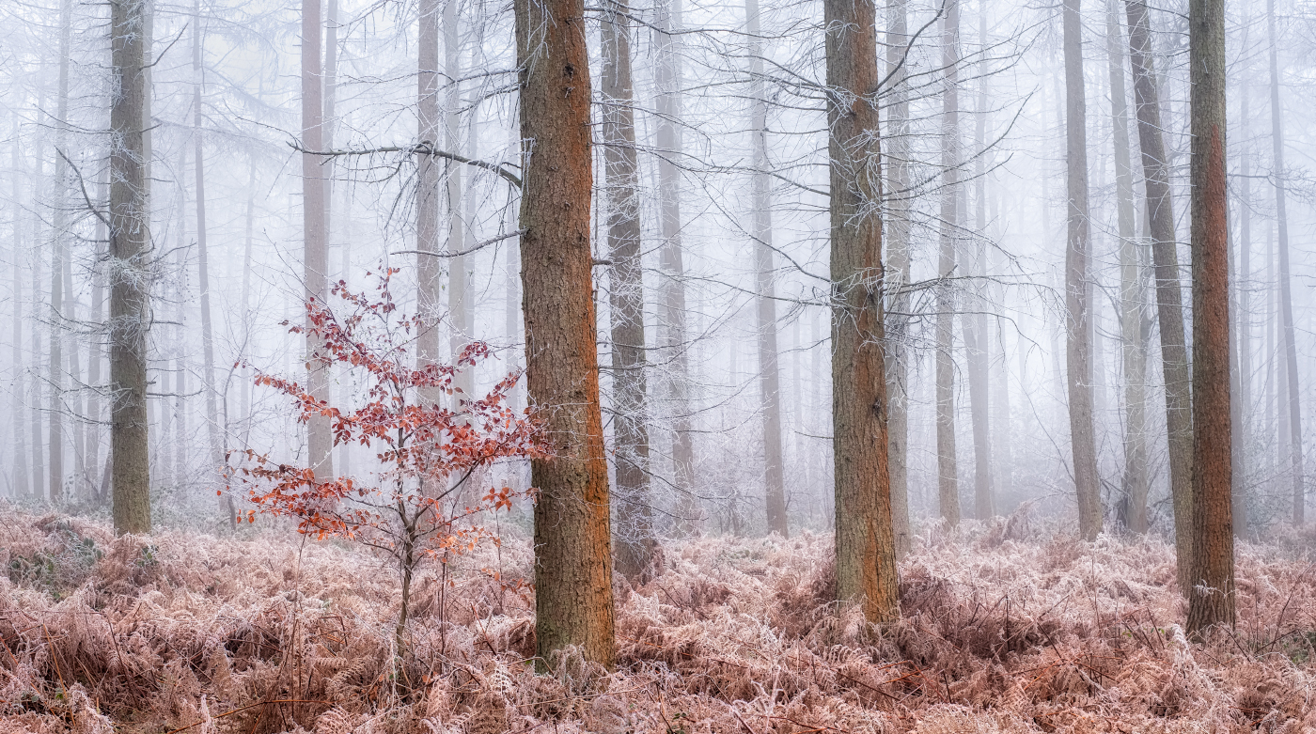
#1 EARLY MORNING ROW
David Harris ARPS, CPAGB #14 IN A LAND OF GIANTS

Slide 45
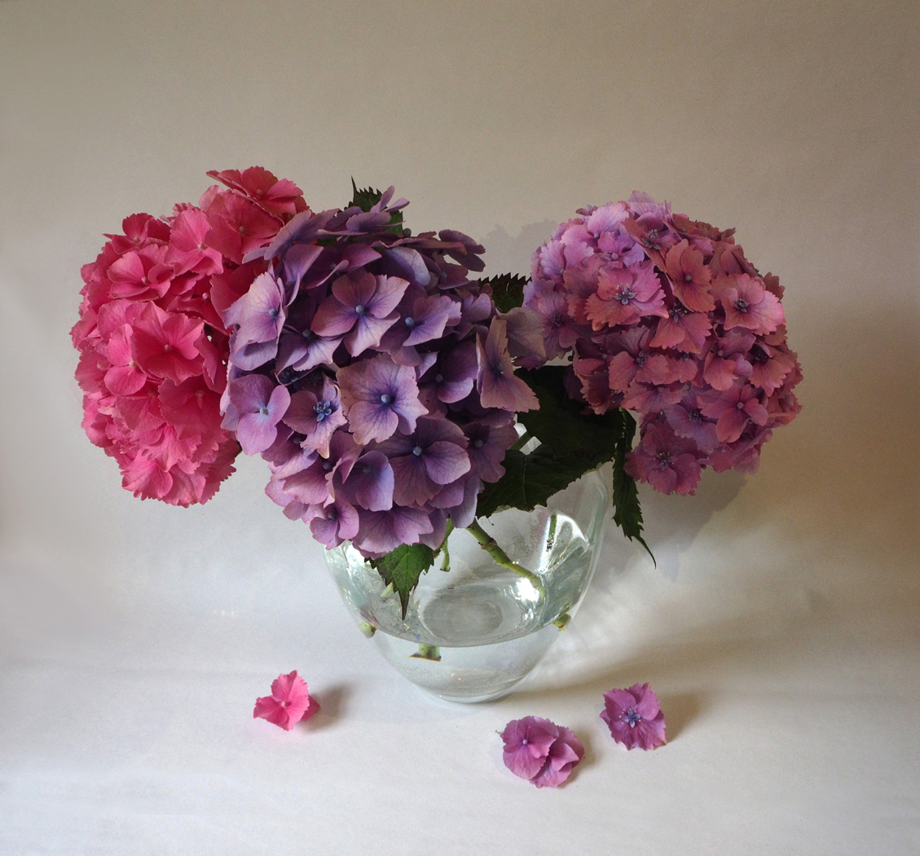
Deena Theaker
#15
HYDRANGEA STILL LIFE
#1 EARLY MORNING ROW

Slide 46
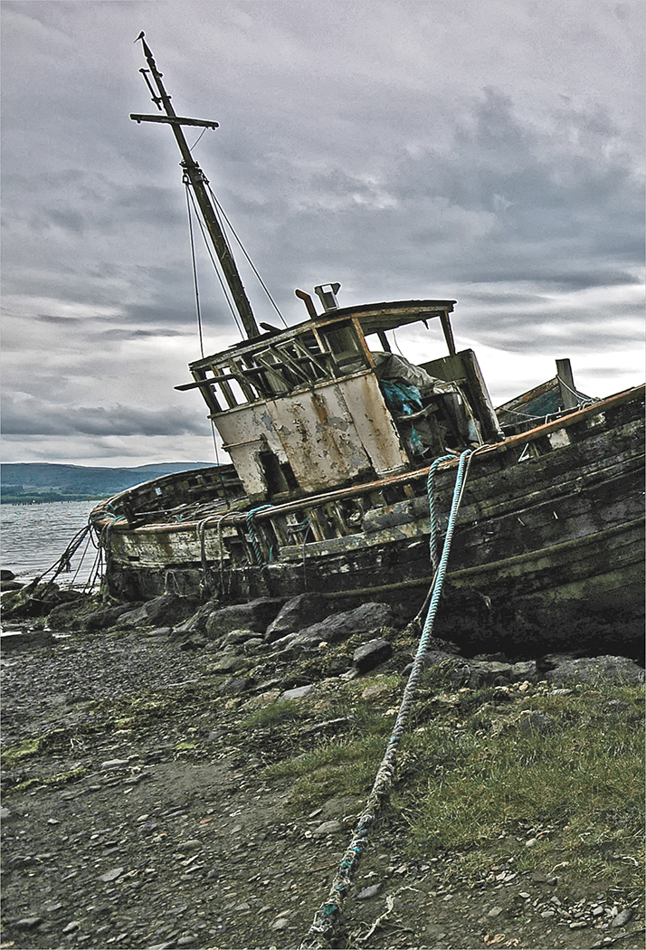
Alan Jaycock
#16
BEACHED FOR GOOD
#1 EARLY MORNING ROW

Slide 47
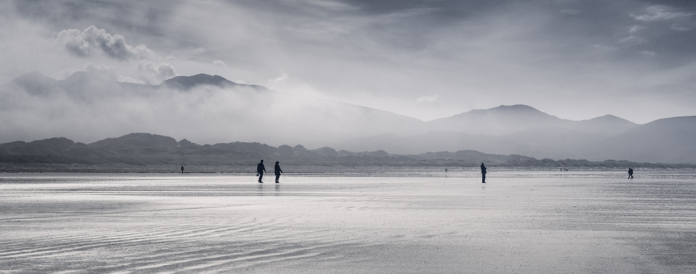
Jan Harris ARPS, CPAGB #17 DISTANCING ON THE BEACH

Slide 48
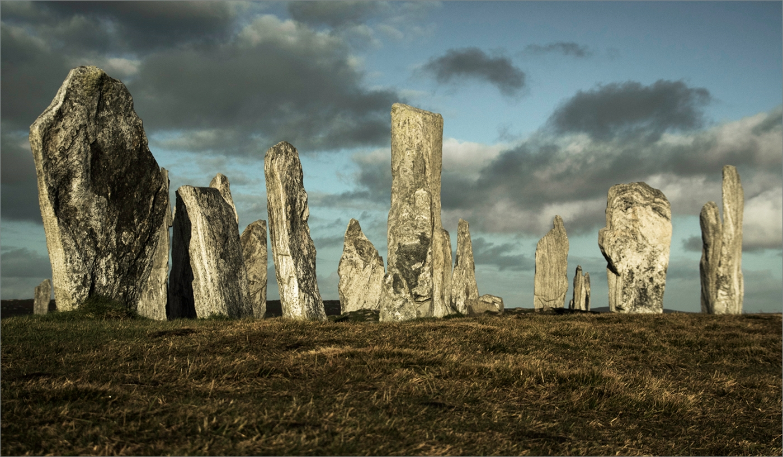
Alan Jaycock #18 CALLANISH STANDING STONES

Slide 49
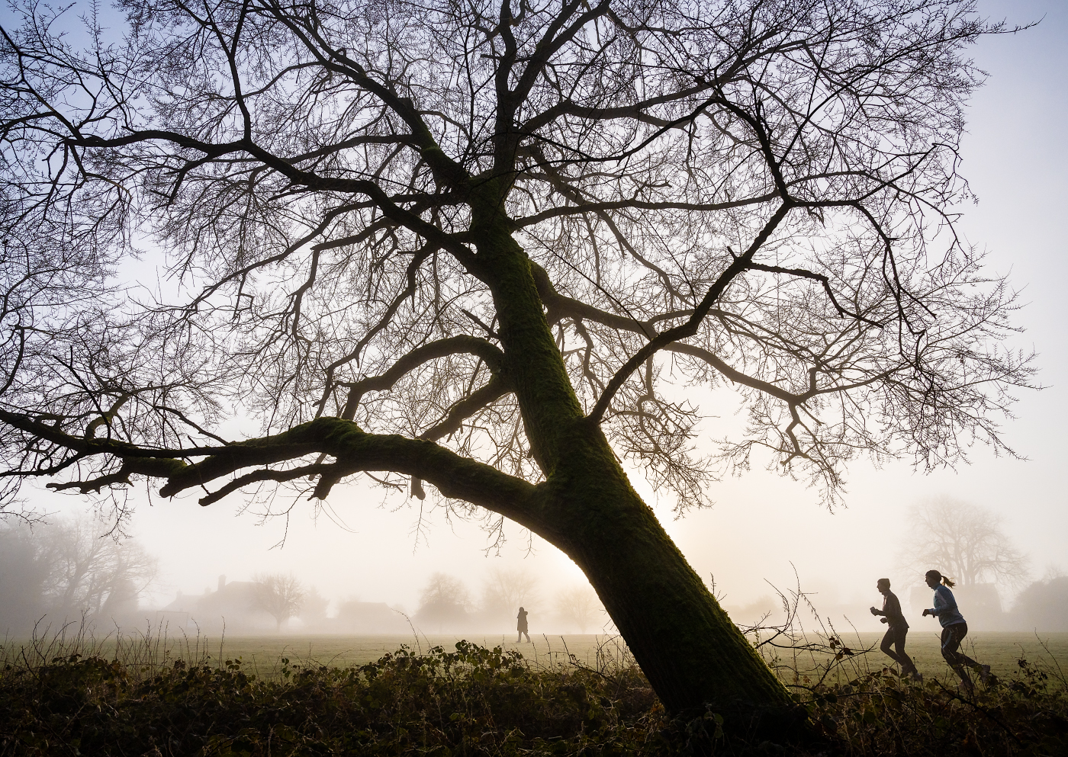
Jan Harris
ARPS, CPAGB
#19
MORNING EXERCISE

Slide 50
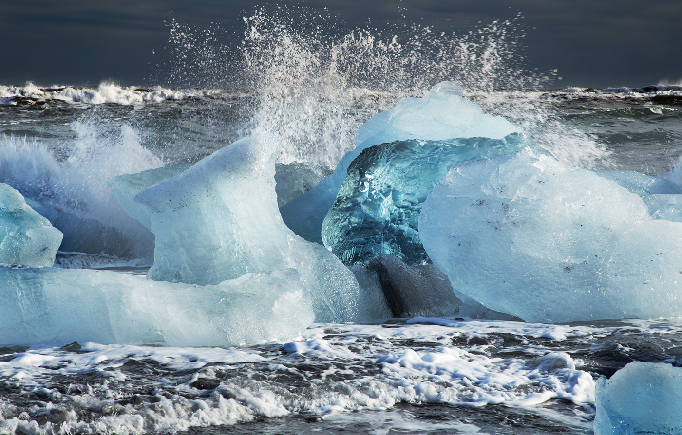
Pat Begley
#20
ICE IN THE SURF

Slide 51
Commended
#1 EARLY MORNING ROW

Slide 52
Peter Davis
#1
LOOSE PAINT
#1 EARLY MORNING ROW

Slide 53
Claire Williams
#9
MARBLED WHITE
#1 EARLY MORNING ROW

Slide 54
Pat Begley
#20
ICE IN THE SURF

Slide 55
Highly Commended
#1 EARLY MORNING ROW

Slide 56
Hilary Pickersgill
#7
INTO THE CLOUDS
#1 EARLY MORNING ROW

Slide 57
David Greenwood
#10
FUNGUS
#1 EARLY MORNING ROW

Slide 58
Winner of the
Derrick Bryant Trophy
#1 EARLY MORNING ROW

Slide 59
#1 EARLY MORNING ROW
David Harris ARPS, CPAGB #14 IN A LAND OF GIANTS

Slide 60
Pictorial - Monochrome
w.h. carden Cup

Slide 61
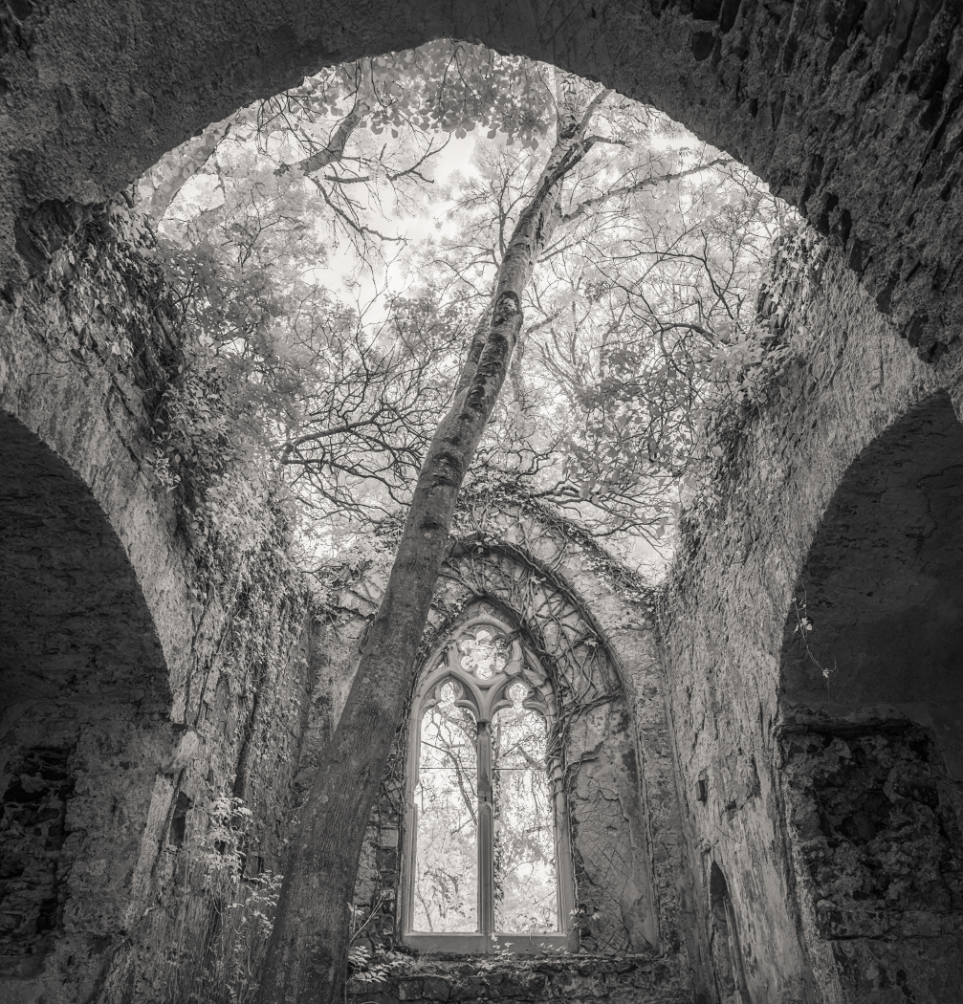
David Harris ARPS, CPAGB
#1
TREE WORSHIP
#1 EARLY MORNING ROW

Slide 62
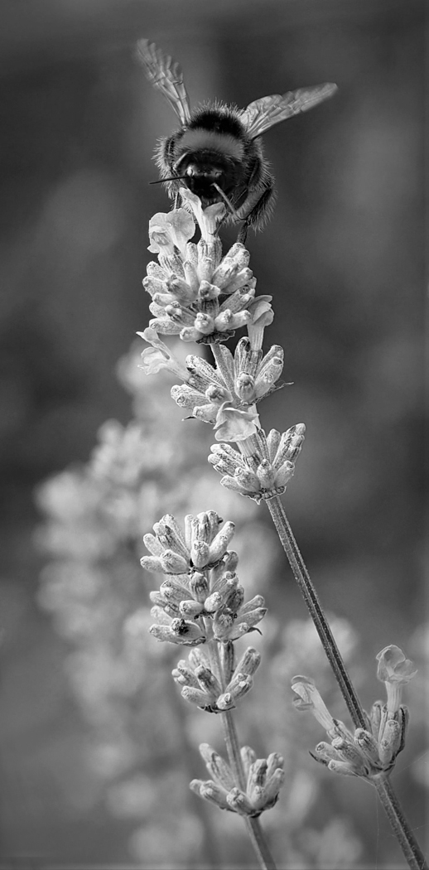
Deena Theaker
#2
BEE ON LAVENDER
#1 EARLY MORNING ROW

Slide 63
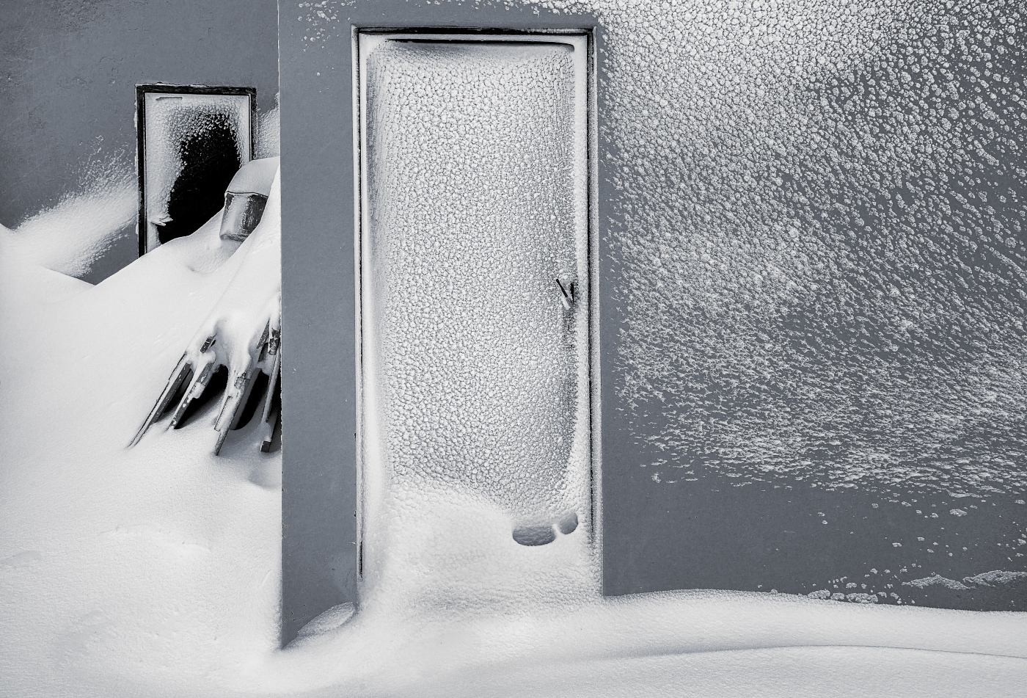
Jan Harris
ARPS, CPAGB
#3
AFTER THE BLIZZARD
#1 EARLY MORNING ROW

Slide 64
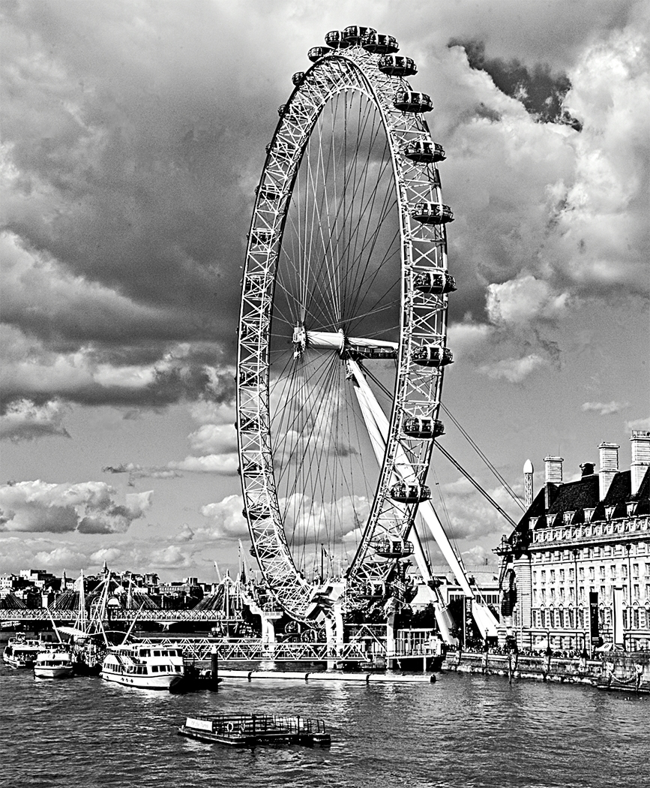
David Greenwood
#4
LONDON EYE
#1 EARLY MORNING ROW

Slide 65
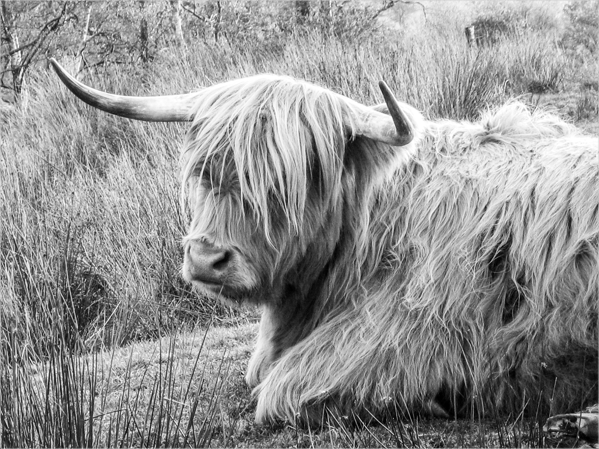
Peter Davis
#5
I NEED A HAIRCUT
#1 EARLY MORNING ROW

Slide 66
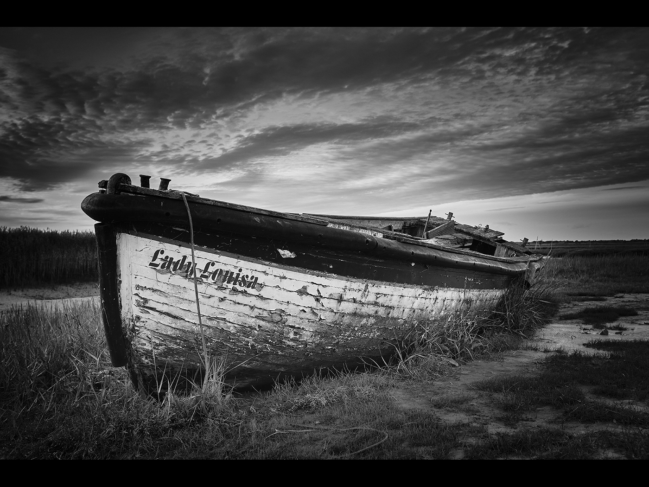
Allan Marshall
#6
LEFT TO THE ELEMENTS
#1 EARLY MORNING ROW

Slide 67
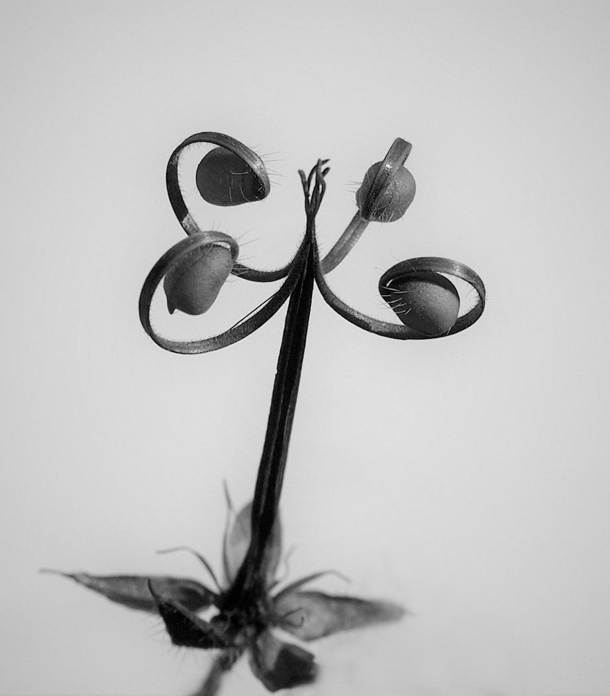
Deena Theaker
#7
SEED HEAD
#1 EARLY MORNING ROW

Slide 68
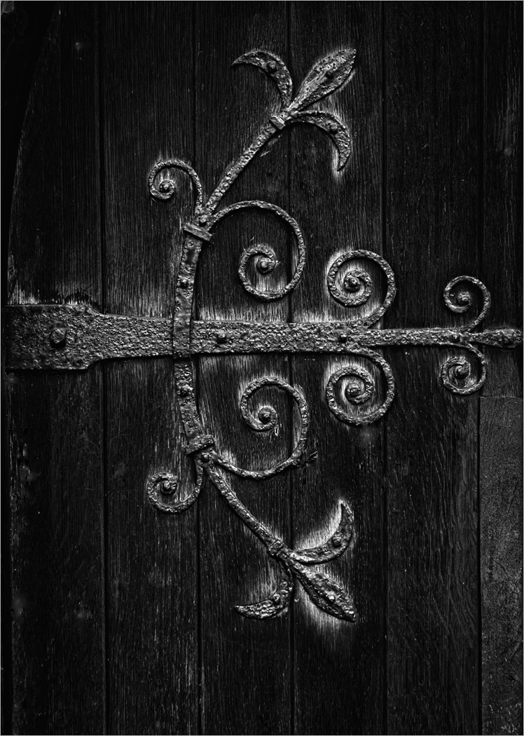
Alan Jaycock
#8
THE OLD CHURCH DOOR HINGE
#1 EARLY MORNING ROW

Slide 69
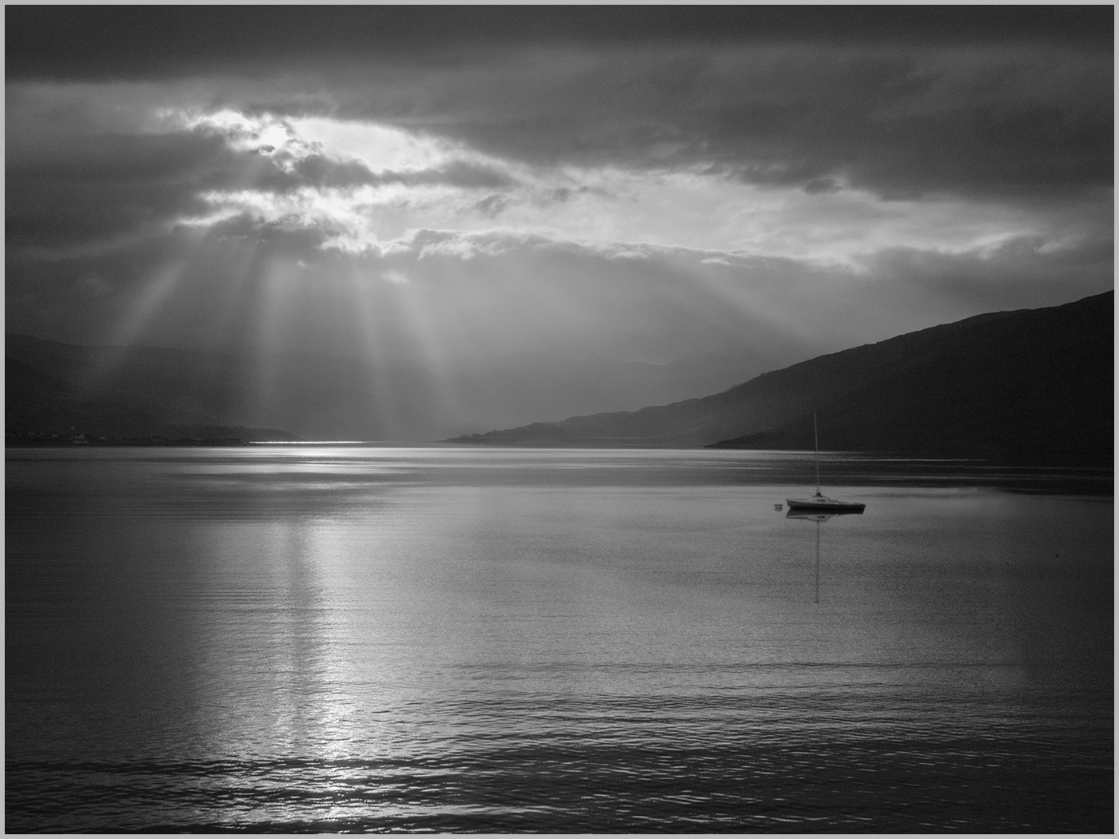
Pat Begley
#9
A BREAK IN THE CLOUDS

Slide 70
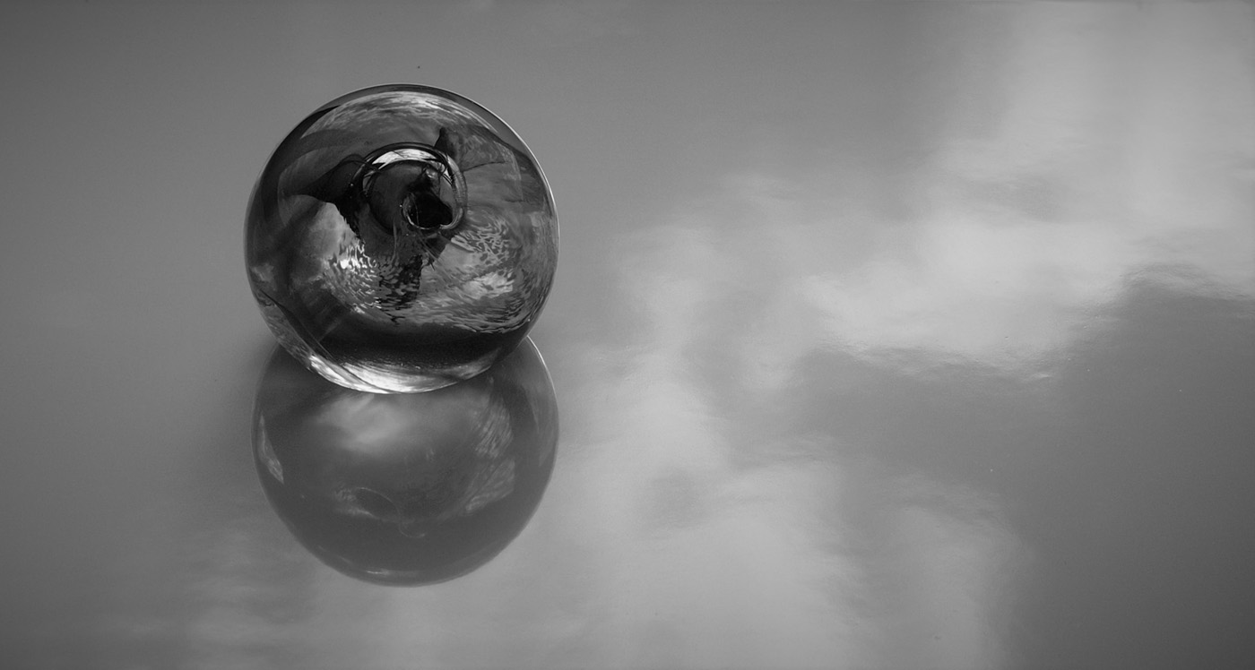
Deena Theaker #10 ORB AND REFLECTION

Slide 71
Teresa Hehir CPAGB
#11
FOOTSTEPS IN THE SNOW

Slide 72
Angus Williamson #12 INTRICATE STEAM LOCO VALVE GEAR

Slide 73
Pat Begley
#13
LLANBERIS TREE

Slide 74
Jan Harris
ARPS, CPAGB
#14
CHILDHOOD IDYLL

Slide 75
David Harris
ARPS, CPAGB
#15
ICE LINES

Slide 76
David Harris ARPS, CPAGB
#16
SEA POWER

Slide 77
Jan Harris ARPS, CPAGB #17
BOTALLACK CHIMNEY

Slide 78
David Greenwood
#18
HAVING FUN

Slide 79
Claire Williamson
#19
SHARP AS NAILS

Slide 80
Allan Marshall
#20
OLD GROYNES

Slide 81
Brenda Spargo
#21
ICE PATTERNS IN A FROZEN PUDDLE

Slide 82
Commended
#1 EARLY MORNING ROW

Slide 83
Pat Begley
#13
LLANBERIS TREE

Slide 84
David Harris ARPS, CPAGB
#16
SEA POWER

Slide 85
Highly Commended
#1 EARLY MORNING ROW

Slide 86
Jan Harris
ARPS, CPAGB
#3
AFTER THE BLIZZARD
#1 EARLY MORNING ROW

Slide 87
Winner of the
W.H. CARDEN cup
#1 EARLY MORNING ROW

Slide 88
Allan Marshall
#20
OLD GROYNES

Slide 89
wildlife
Margaret beer trophy

Slide 90
Teresa Hehir CPAGB
#1
SQUACCO HERON
#1 EARLY MORNING ROW

Slide 91
#1 EARLY MORNING ROW
Peter Davis #2 SPRINGING INTO ACTION

Slide 92
Alan Jaycock
#3
PORTRAIT OF A SHORT EARED OWL

Slide 93
Angus Williamson
#4
COCK A DOODLE

Slide 94
Brenda Spargo
#5
OWL WITH ATTITUDE

Slide 95
David Greenwood
#6
BLACK SWAN

Slide 96
Carole Dixon
#7
FED UP OF SOCIALLY DISTANCING

Slide 97
Alan Marshall #8 REED BUNTING

Slide 98
Hilary Pickersgill
#9
MARBLED WHITES MATING

Slide 99
David Greenwood
#10
GOSHAWK

Slide 100
Teresa Hehir CPAGB #11
GIRAFFE DRINKING

Slide 101
Teresa Hehir CPAGB
#12
MEADOW GRASSHOPPER

Slide 102
Peter Davis
#13
LYNX PORTRAIT

Slide 103
#14
THE KISS

Slide 104
Commended
#1 EARLY MORNING ROW

Slide 105
Teresa Hehir
#12
MEADOW GRASSHOPPER

Slide 106
Peter Davis
#13
LYNX PORTRAIT

Slide 107
Highly Commended
#1 EARLY MORNING ROW

Slide 108
Hilary Pickersgill
#9
MARBLED WHITES MATING

Slide 109
Winner of the
Margaret beer trophy
#1 EARLY MORNING ROW

Slide 110
Teresa Hehir CPAGB
#1
SQUACCO HERON
#1 EARLY MORNING ROW

Slide 111
congratulations
Jan Harris ARPS, CPAGB – Best Landscape – Stan Holbrook Trophy – Winter in Assynt
David Harris ARPS, CPAGB – Best Pictorial, Colour – Derrick Bryant Trophy – In a Land of Giants
Allan Marshall – Best Pictorial, Monochrome – W.H. Carden Cup – Old Groynes
Teresa Hehir CPAGB – Best Wildlife – Margaret Beer Trophy – Squacco Heron

Slide 112
Congratulations
To the following
Highly commended & commended
Landscape:
Highly Commended – Hilary Pickersgill – Sunlit Through The Clouds
- Allan Marshall – Over Textured Dunes
Commended – Allan Marshall – Horsey Mill, Norfolk
Pictorial Colour:
Highly Commended – Hilary Pickersgill – Into The Clouds
– David Greenwood – Fungus
Commended – Peter Davis – Loose Paint
- Claire Williams – Marbled White
- Pat Begley – Ice In The Surf

Slide 113
Congratulations
To the following
Highly commended & commended
Pictorial Monochrome:
Highly Commended – Jan Harris ARPS, CPAGB – After the Blizzard
Commended – Pat Begley – Llanberis Tree
- David Harris ARPS, CPAGB – Sea Power
Wildlife:
Highly Commended – Hilary Pickersgill – Marbled Whites Mating
Commended – Teresa Hehir CPAGB – Meadow Grasshopper
- Peter Davis – Lynx Portrait

